Slide 1

SMART WEATHER STATION
KASUN THUSHARA
ELECTRONIC RESEARCH SCIENTIST
SRI LANKA INSTITUTE OF NANO TECHNOLOGY
kasunthushara16855@gmail.com

Slide 2
OUTLINE
Introduction
Hardware architecture
Data aquation
Model selection
Tiny ML model
Real world Implementation

Slide 3
Introduction
The atmosphere is changing all the time, and due to that, the above parameters can be changed.
Ultra low power Edge intelligence device with good accuracy
Low cost ,less maintain without moving parts
Short terms weather prediction
IoT enable

Slide 4

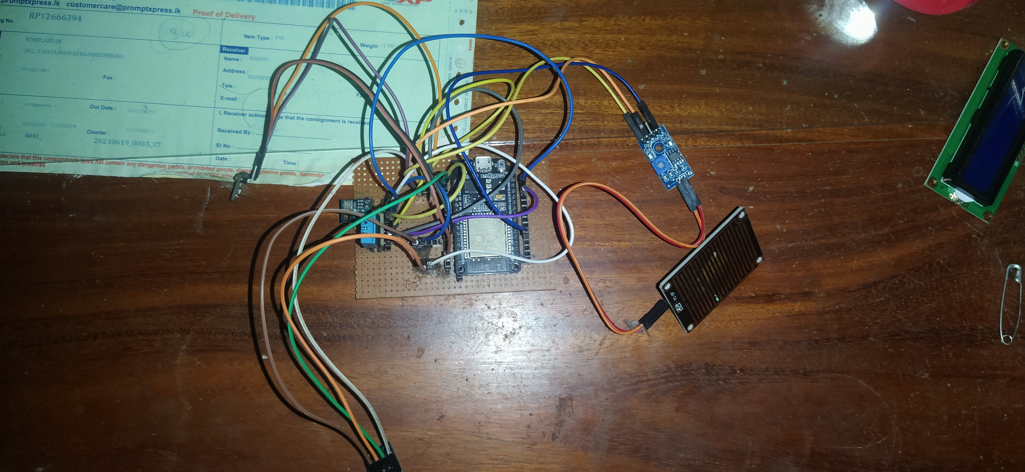
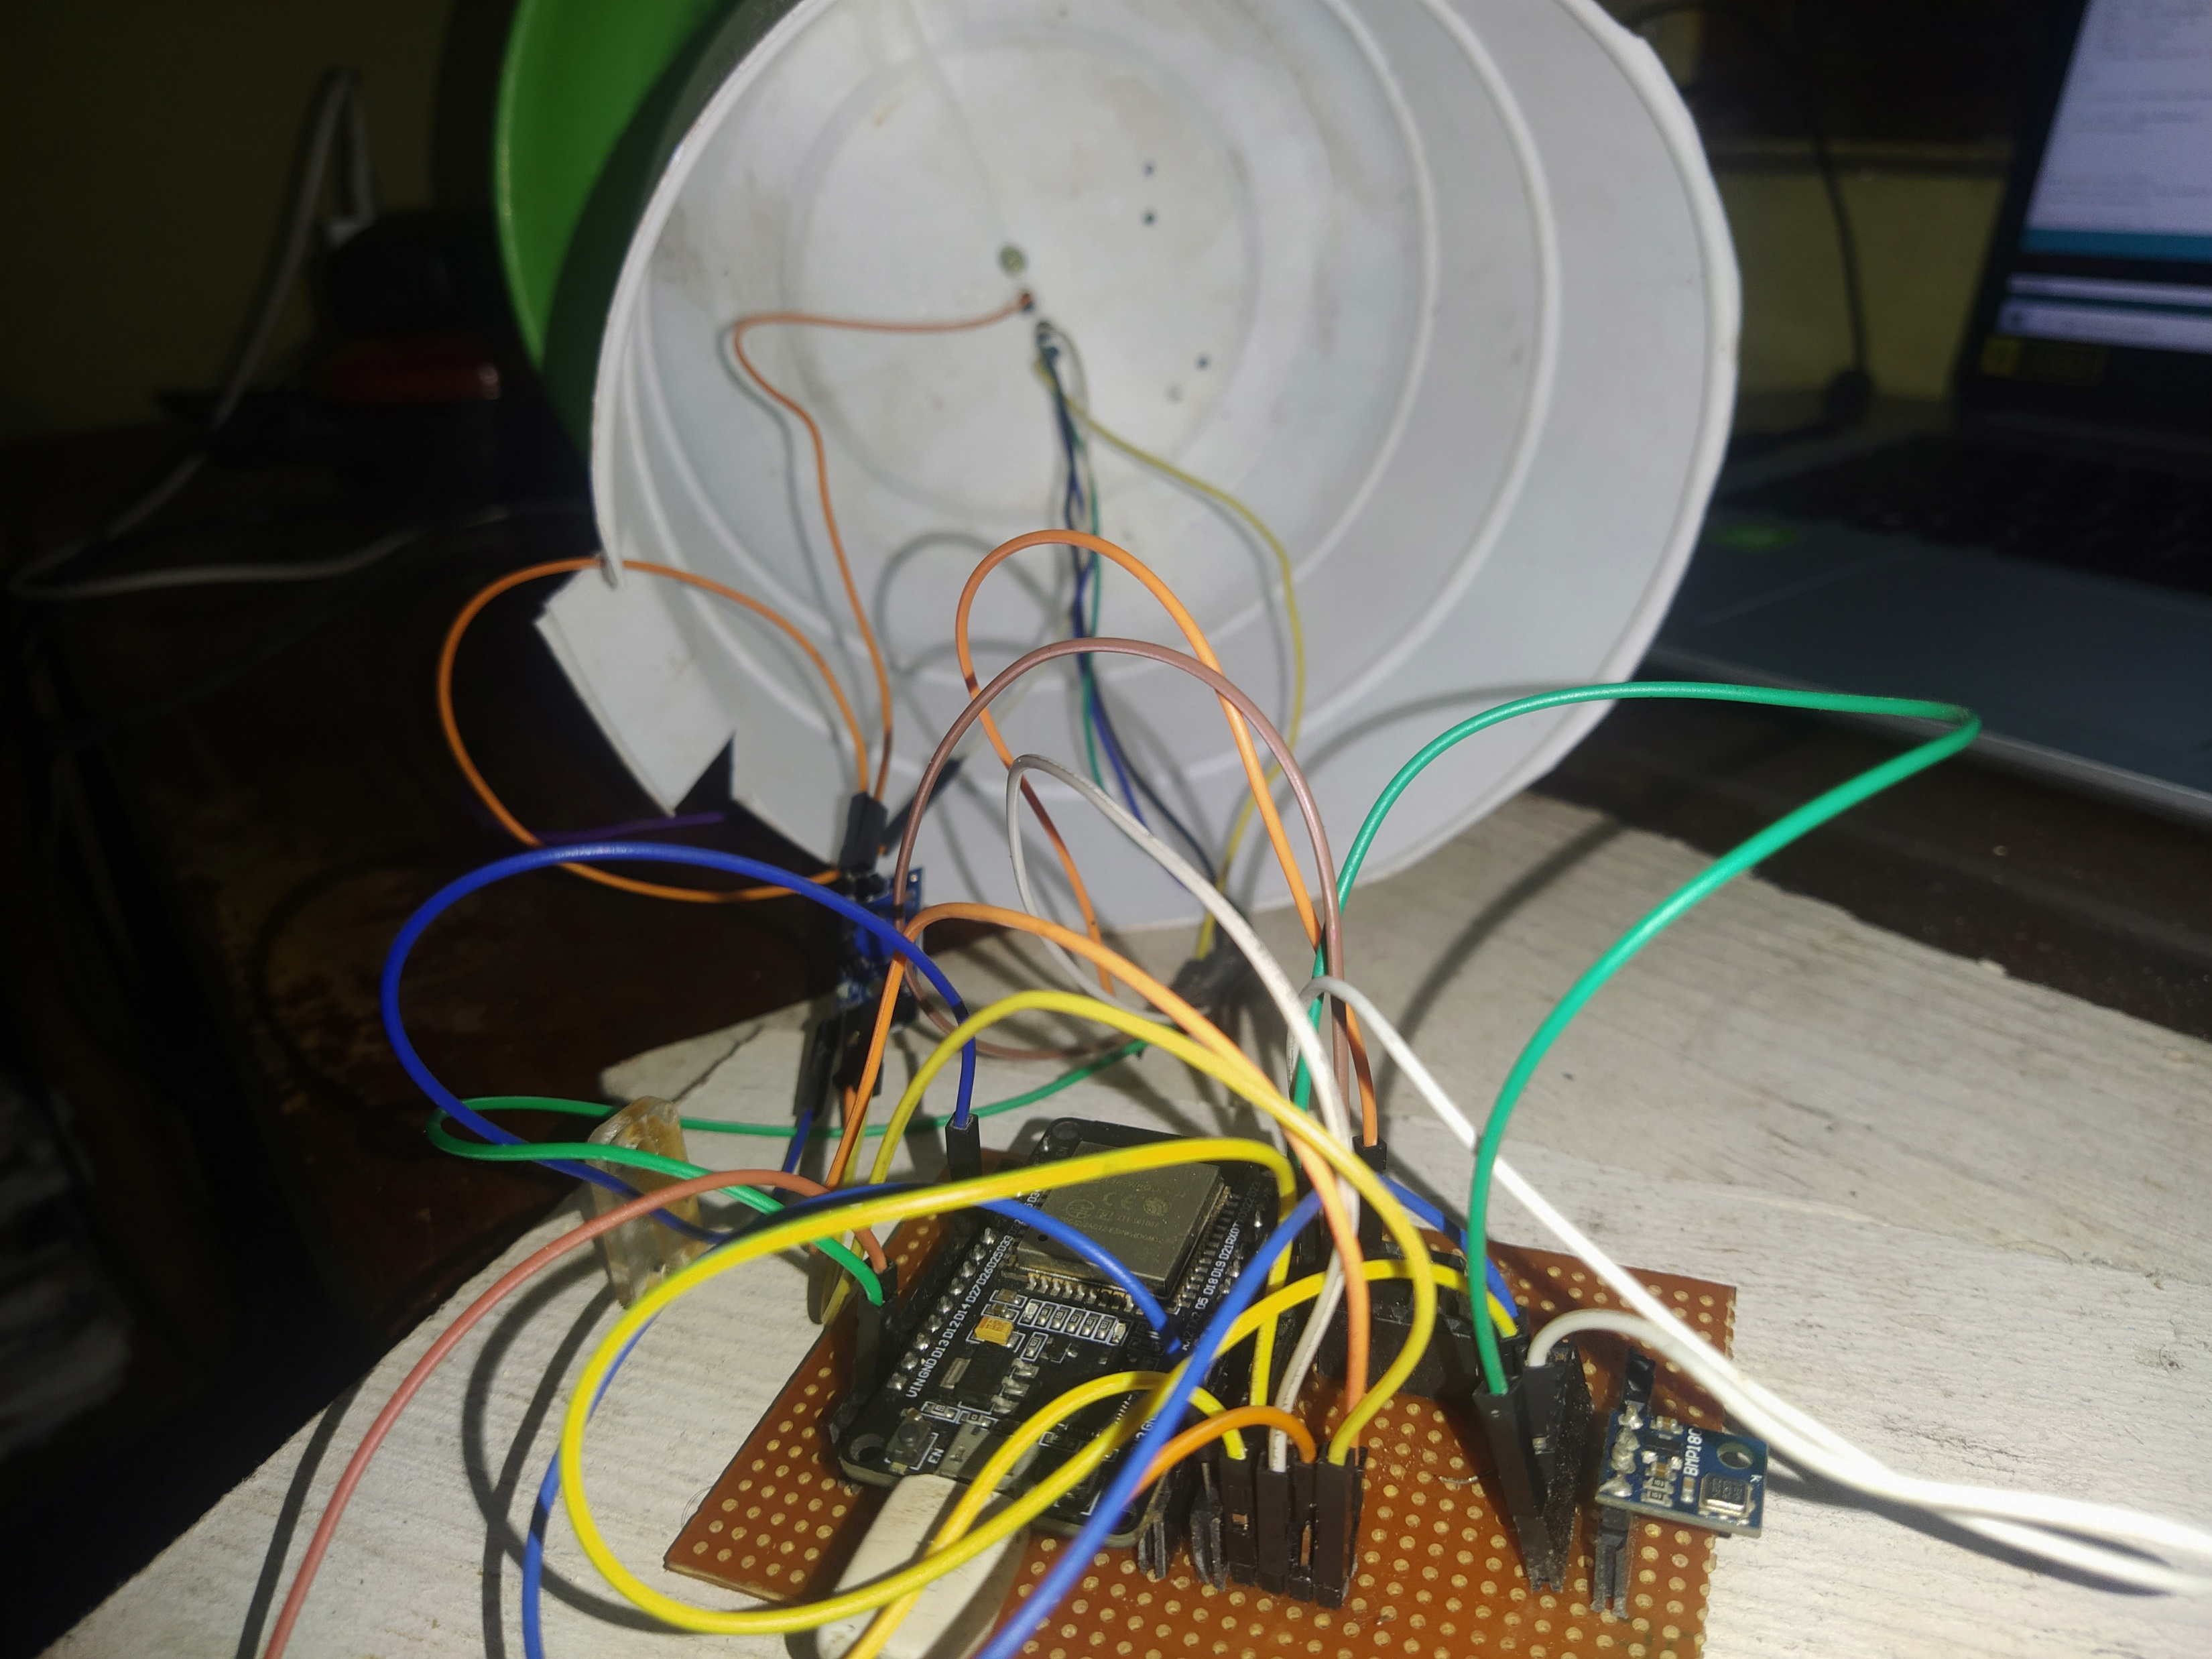
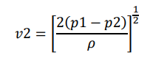
Hardware Architecture
Microcontroller
Ability to deploy the tiny-ML model
IoT enabled SoC
Choosing sensors
DHT 11
BMP280 BME180
Rain Sensor

Slide 5
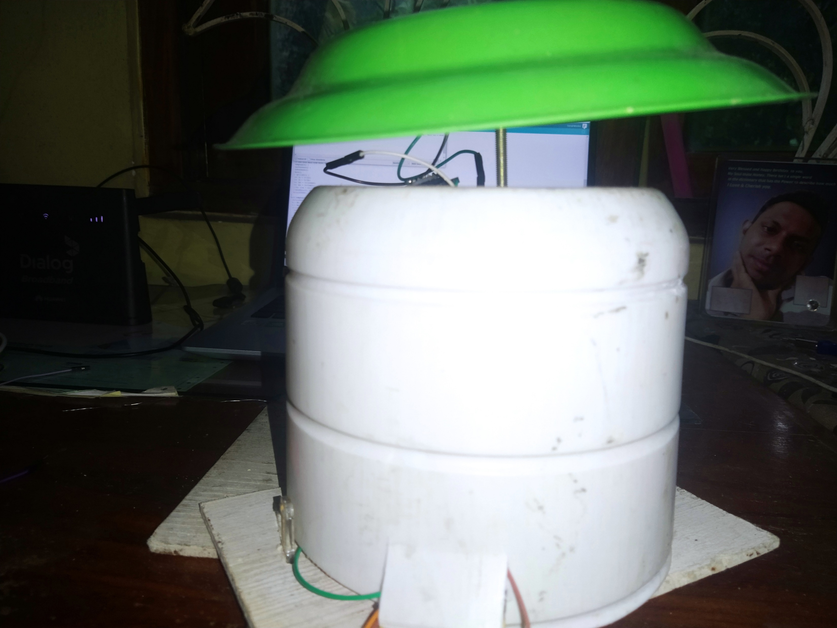
Hardware Architecture-Cont.
Enclosure is made from plastic Ice Cream container and the roof is made from plastic plate.

Slide 6

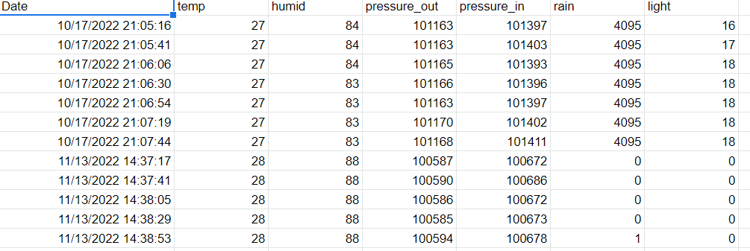
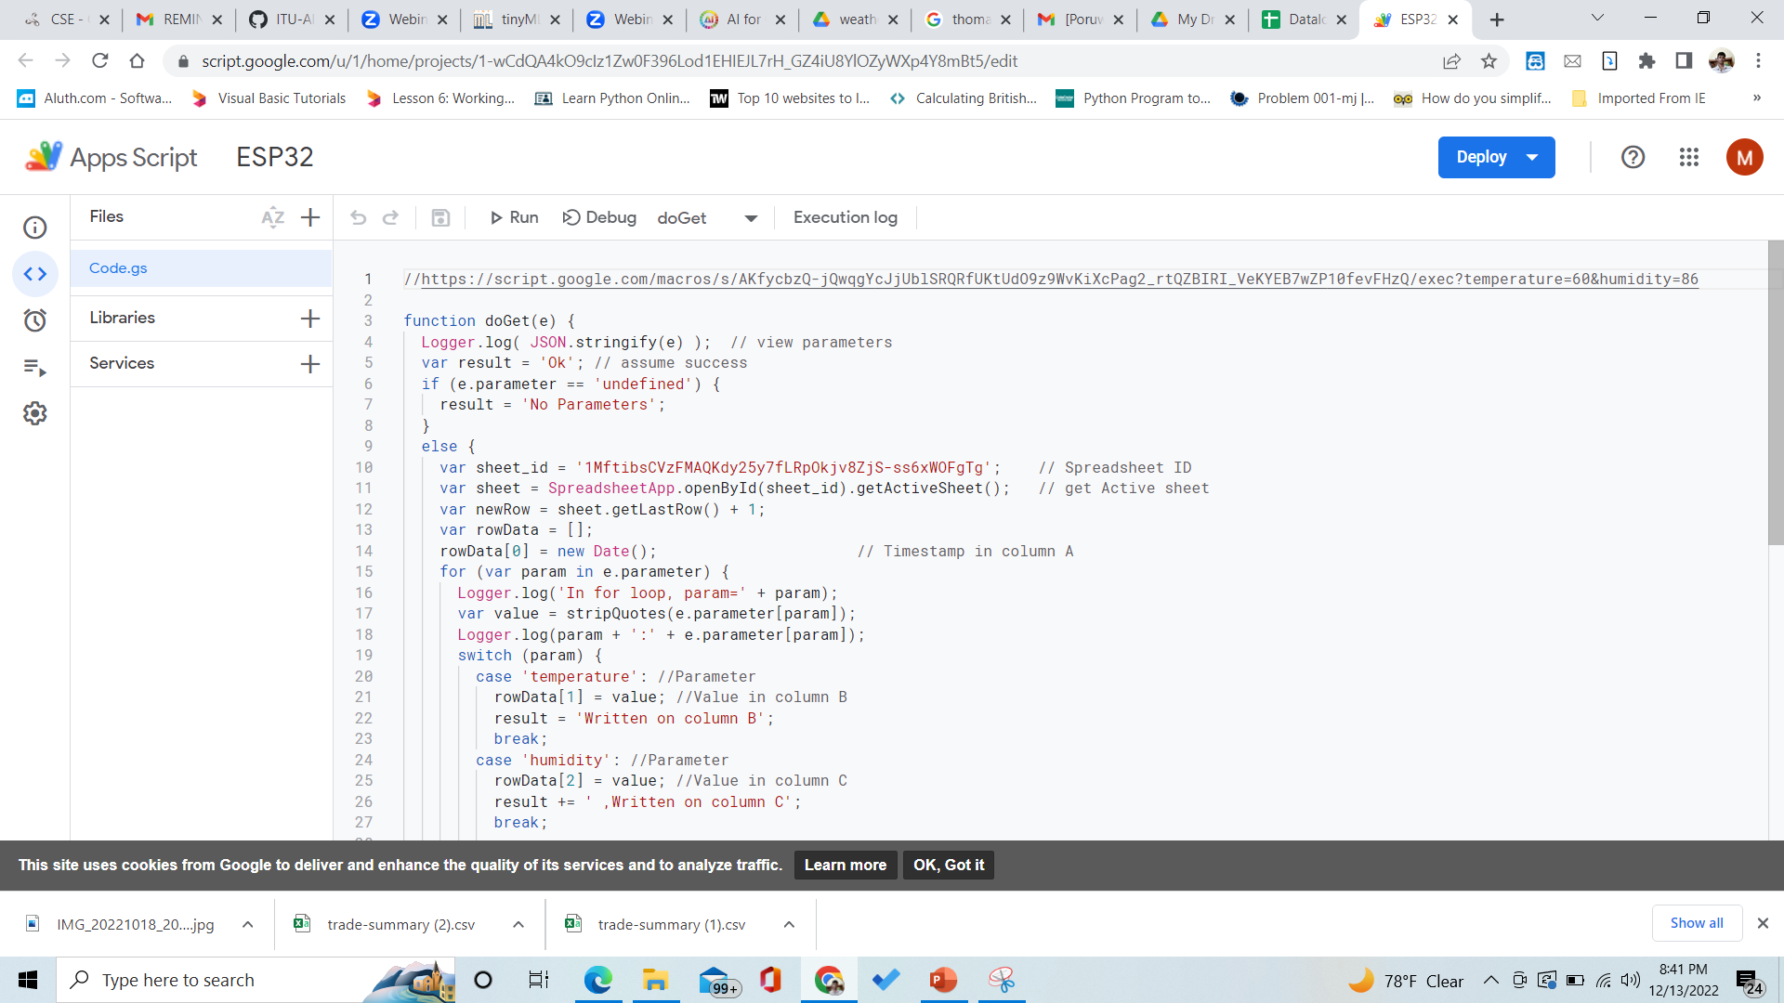
Data Aquation
Using Google Sheets and Scripts

Slide 7

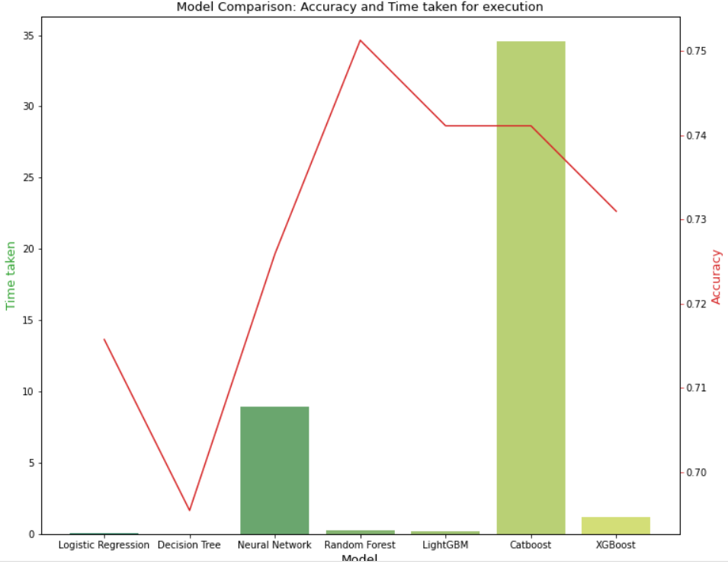
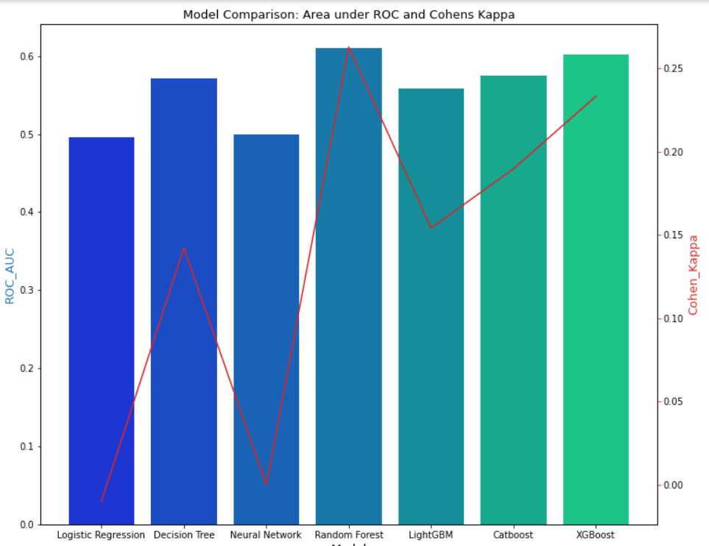
Model Selection
Scikit-Learn Python library to train the model
Target variable is Next hour precipitation
Logistic regression, Decision tree, Neural network, LGBM, CatBoost, Random Forest regression, and XGBoost were trained and tested.

Slide 8
Tiny ML Model
Looking over results I choosed Random forest classifier.
Micro-ML python library
https://pypi.org/project/micromlgen/
Model is converted to C++ code.

Slide 9
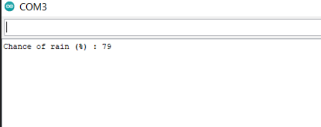
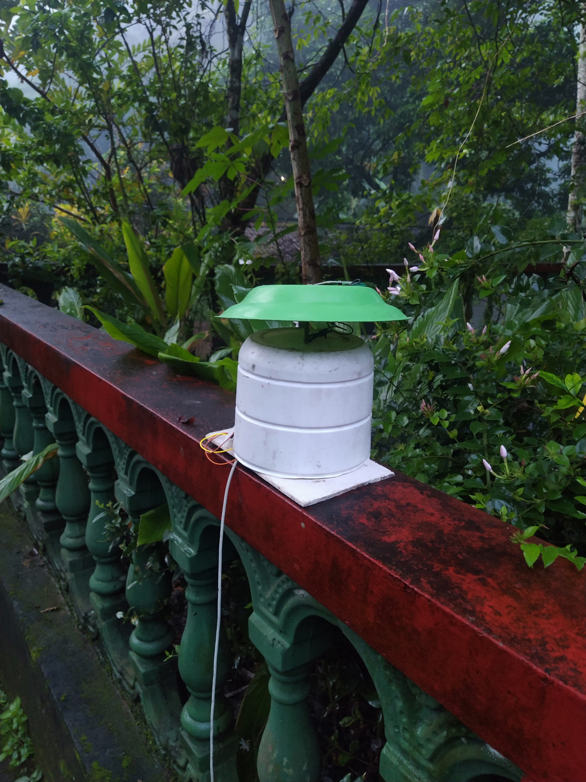
Real World implementation

Slide 10
Conclusion
Using the ESP-32 module gives me more flexibility and possibilities to improve this in an IoT manner.
By increasing the small amount of data, I believe that accuracy will increase to 85%
Tiny ML model with embedded solution, Low power, Low cost, No moving parts and accurate criteria were achieved.

Slide 11


